Slide 1
SIC-VM Group Project
Selma Eklund, Jacob Vorndran, Jacob McGowan

Slide 2

Tools and Languages
As a group we have the most experience in Java. With extensive documentation and examples on GUI, we can build out our program with confidence that it is possible.
Using GitHub, we can clone the files and edit them on there IDE.
Then when changes are made we can all integrate them onto the main repo.

Slide 3

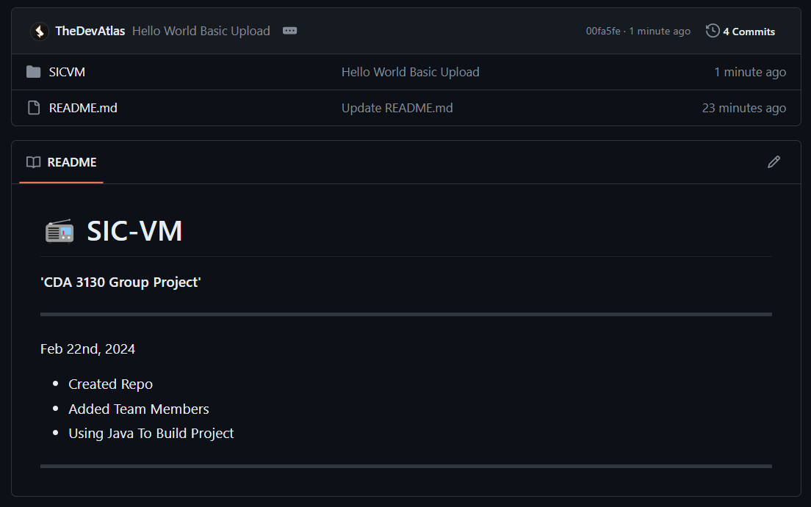
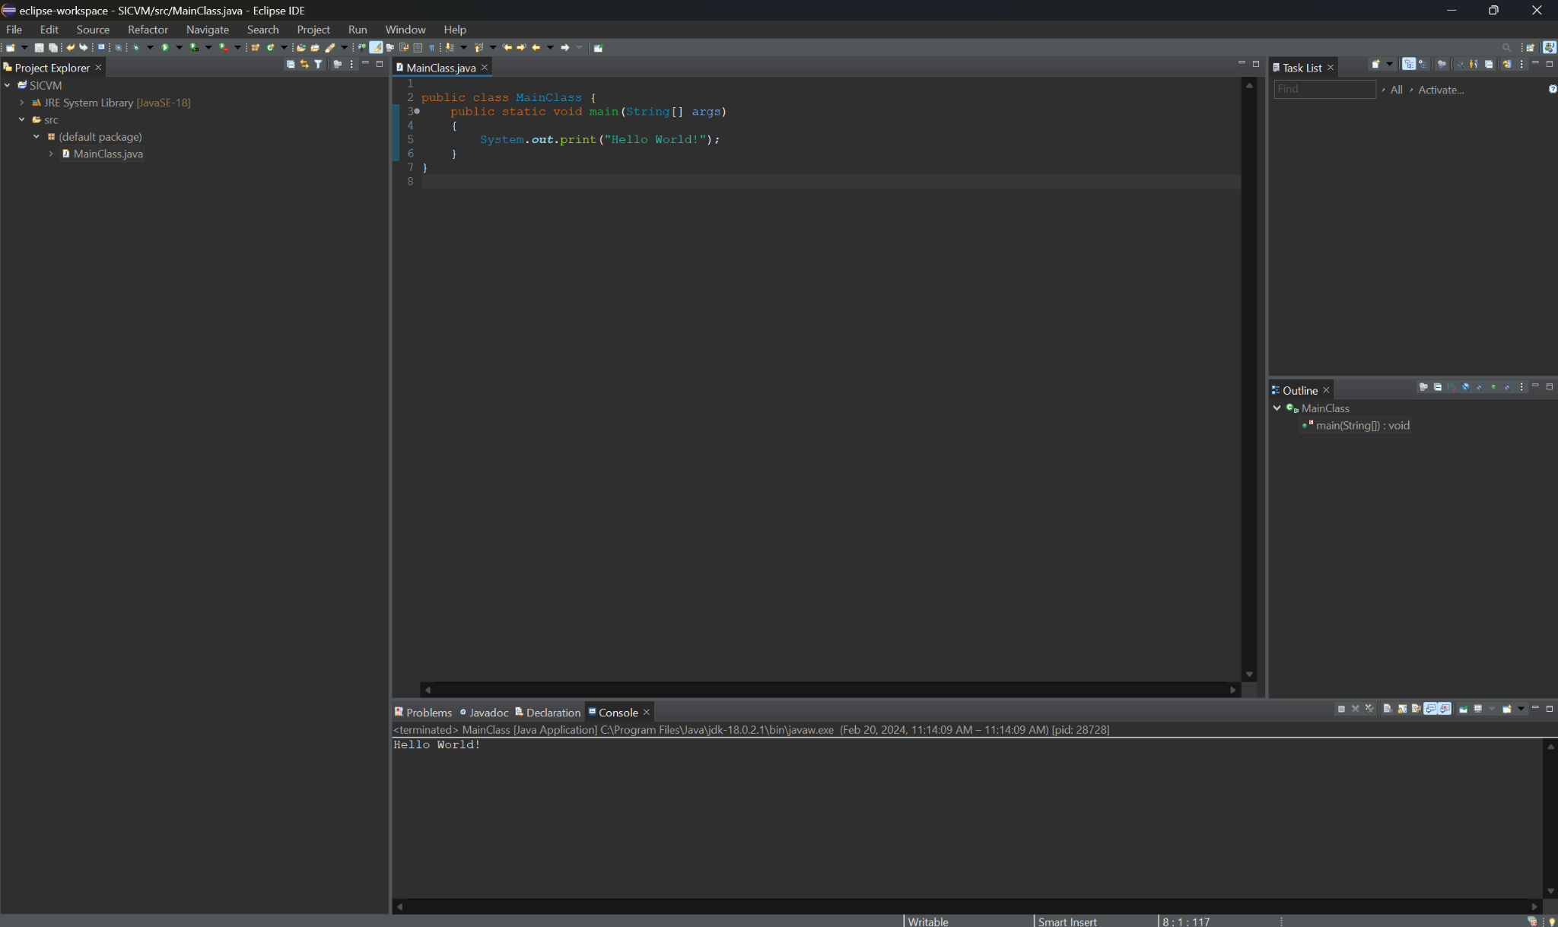
GitHub Repo
Our GitHub repo has been setup with a basic Java project so that we are fully set up for fulfilling project goals.

Slide 4
Project Goals - abstract window toolkit (awt)- Java.file.io - lots of text boxes
File Input - read a file using Java.file.io
GUI Window - Java.AWT
User Input (Buttons) - Included with AWT - control the program
Save States (File Output) - output a file using Java.file.io
Load State From File - read a different file using Java.file.io
Memory Display - a big text box that is formatted using GUI
Display What The Command Is - a text box that shows the command

